Slide 1
ID1054 DIGITAL FABRICATION
Group 19

Slide 2
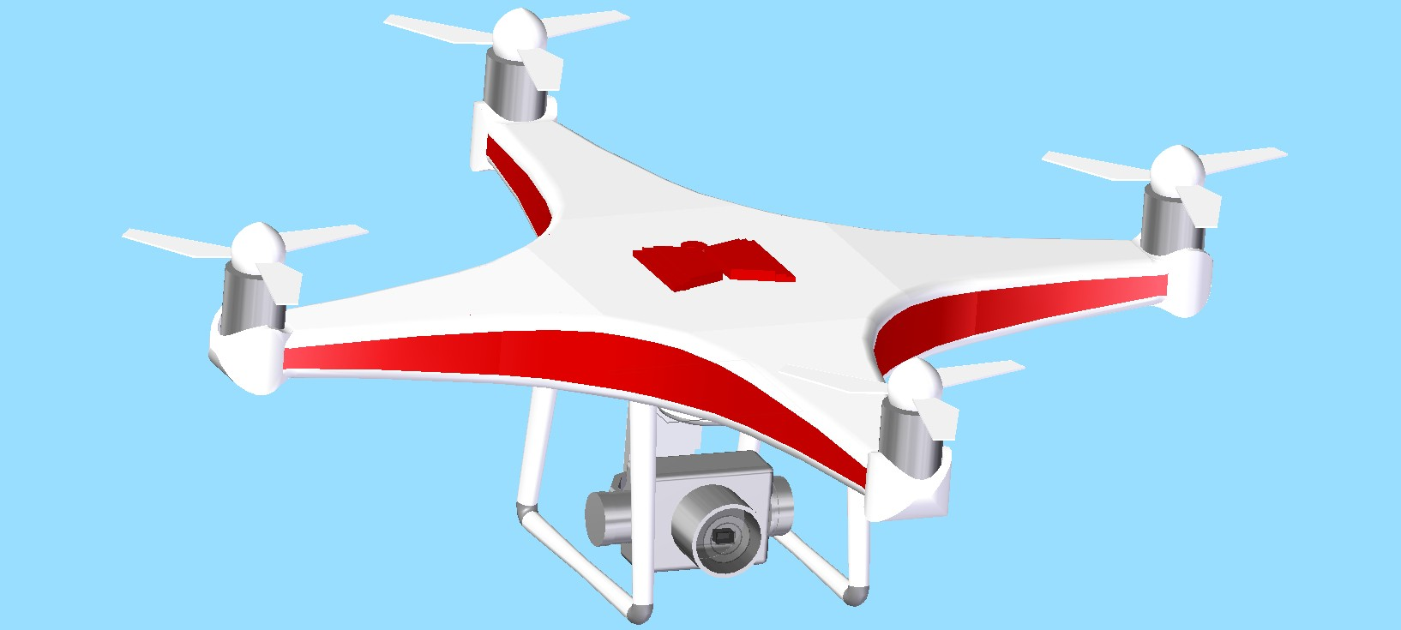
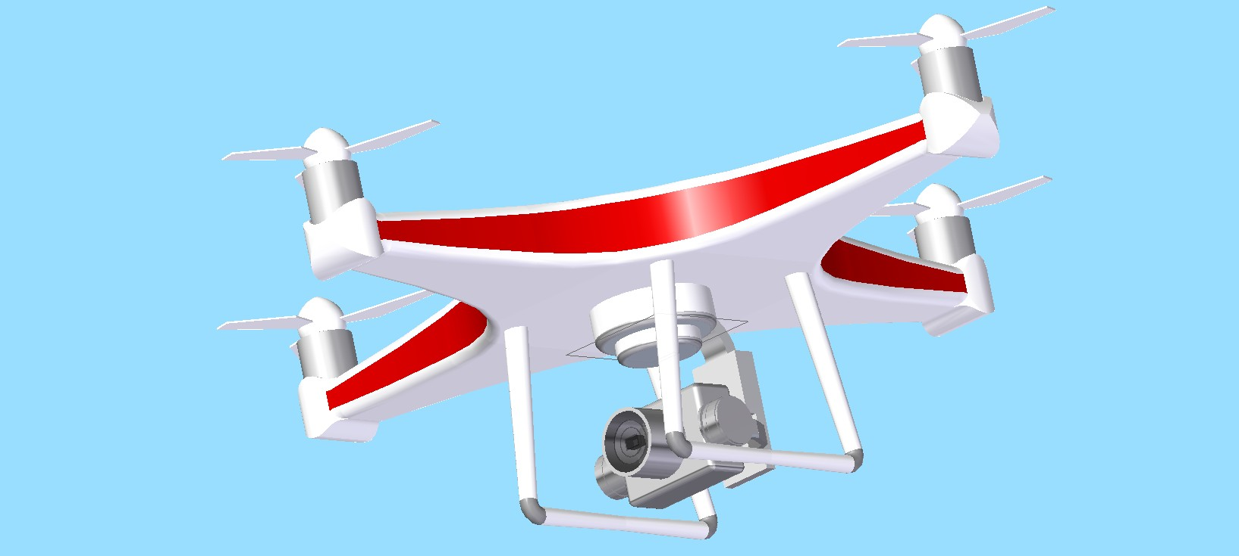
Quadcopter 3D Model

Slide 3
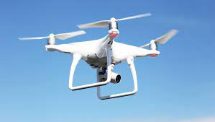
Genesis of the project:
As in our country, many accidents happen because of the breaking of traffic rules.
Also, the traffic policies cannot cover all the towns and cities.
So, we got an idea to design a drone with a camera so that it captures the images of the vehicles which violate the rules.

Slide 4
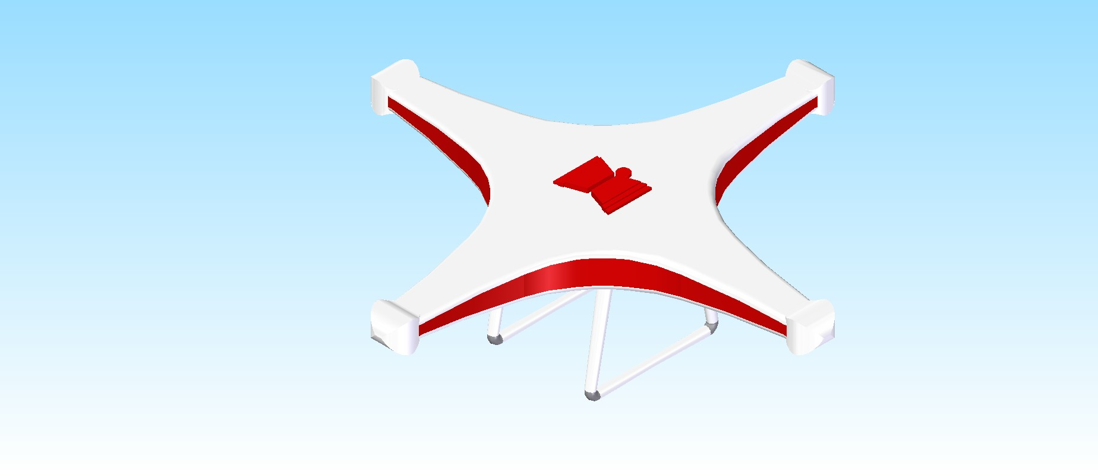
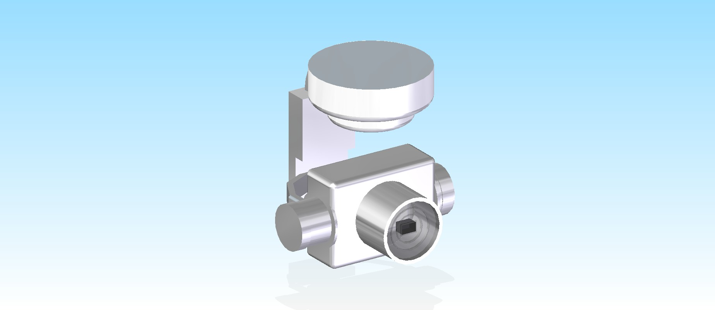

Different Parts of the Model
Body
Camera
Propellor

Slide 5
Difficulties Faced
Designing the curved shape on the body’s side is very challenging.
Making so many extrusions and cuts in the front part of the camera was a tough part.
More difficult part is to choose the dimensions of each part and scaling them properly in the assembly file.

Slide 6
3D Printing Data:
Software used : Mojo Print Wizard
Settings :
Part Interior – Solid
STL Units – Inches
Scale – 1.43
Dimensions – 5“ x 4.98“ x 1.65“
Part Orientation – X : 0 Y : -180 Z: 0
(The body of the drone must be parallel to XY plane to decrease the Staircase Effect and increase the strength.)

Slide 7
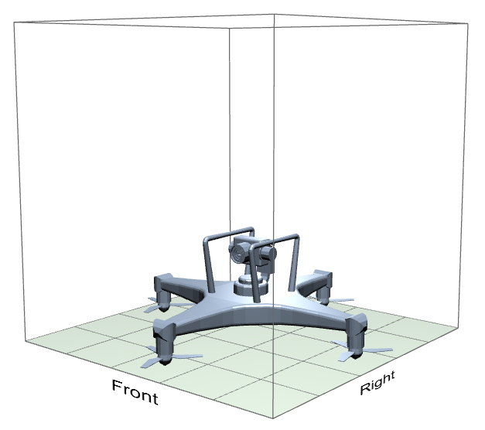
Build Estimates :
Time : 5 hr 3 min
Model Material : 1.81 in^3
Support Material : 1.11 in^3

Slide 8
Project credits
Patnala Vikas (CS20BTECH11037) - Propellers
Danda Sai Pravallika (CS20BTECH11013) - Body
Vojeswitha Gopireddy (AI20BTECH11024) - Camera
Itreddy RajaSekhar (CS20BTECH11020) - Assembly
Bathini Lakshmi Pranathi (EE20BTECH11009) - Slides

